Slide 1
BLACK HOLES
By:
G.Sai Nikhil
Id.no:180040034.

Slide 2
INTRODUCTION
A blackhole is a region of space from which nothing,not even light can escape.It is the result of the deformation of space time caused by very compact mass.Around a black hole there is an undetectable surface which marks the point of no return,called an event horizon.
It is called ‘’black” because it absorbs all the light that hits it,reflecting nothing, just like a perfect blackbody in thermodynamics.it works similarly as a black body works in quantum mechanics.

Slide 3
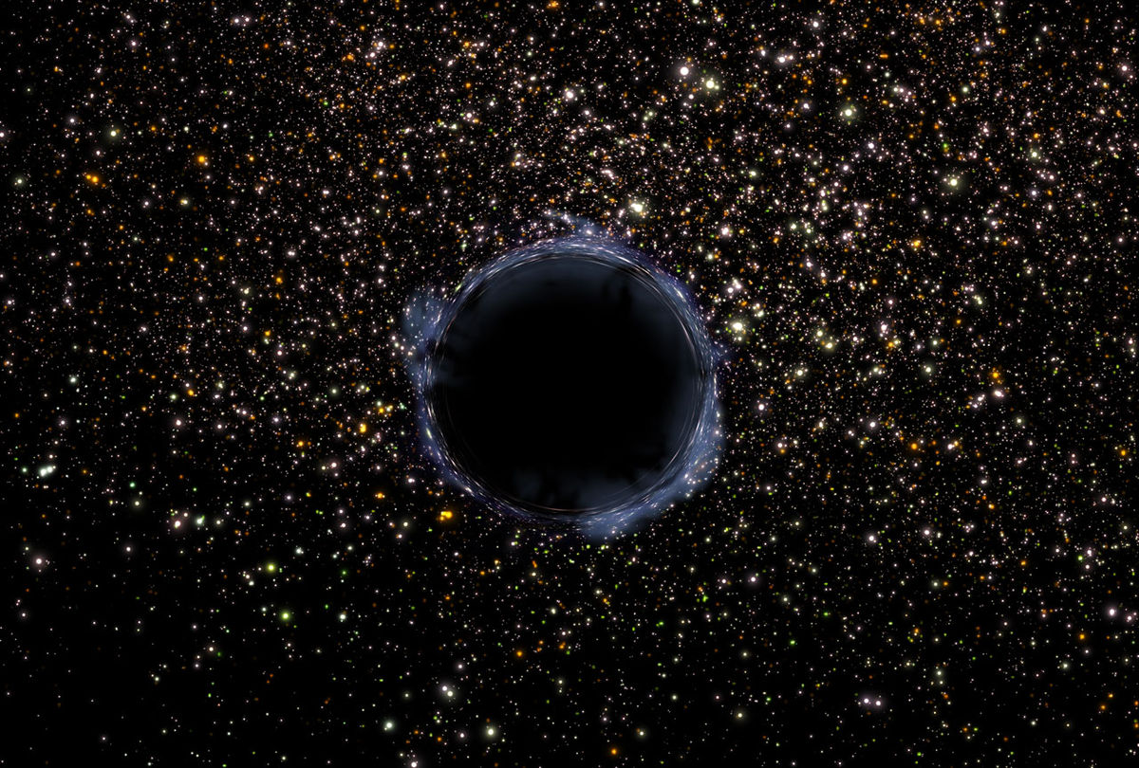
History
The idea of a body so massive that even light could not escape was first put forward by geologist john michell in a letter written to henry cavendish in 1783 to the royal society.
In 1939,American physicist Robert Oppenheimer
Developed a possible explanation for the nature of these points of infinite density,At this oint the star is a black hole.

Slide 4
HOW DO THE BLACK HOLE FORM?
There are many theories to that question.
Most common theory is where a colossal star with mass of more than 3 times the sun’s reaches the end of its life,gets crushed under its own gravity,leaving behind a compact blach hole.
When a gigantic star reaches the final stage of its life and is about to go supernova,it spends all the nuclear fuel by then.So it stops burning and heating up and fuel by then.so it stops burning and heating up and cannot create the nuclear energy required to feed the star.

Slide 5
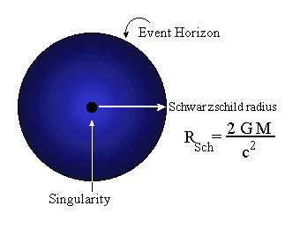
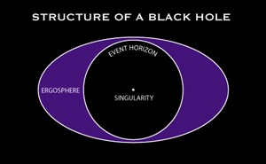
STRUCTURE OF BLACK HOLE
Although black holes come in a variety of masses and sizes,their structures are all alike. A black hole’s entiremass is concentrated in an almost infinitely small and dense point called a singularity.This point is surrounded by the event horizon.And a rotating black hole is surrounded by the ergosphere,a region in which the black hole drags space itself.

Slide 6
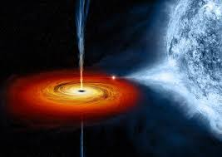
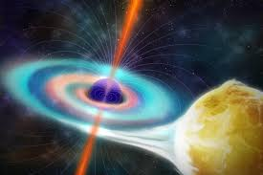
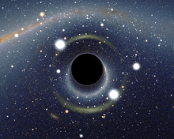
GROWTH OF BLACKHOLE.
Once a black hole as formed,it can continue to grow by absorbinh additional matter.Any black hole will continually absorb gas and interstellar dust from its direct surroundings and omnipresent cosmic background radiation.
Another possibility is for a blackhole to merge with other object such as star or even other black holes.

Slide 7
IS THE BLACK HOLE DANGEROUS?
Black holes are so massive that nothing,not even light,can escape its path.so that means that even stars and asteroids or much less anything in its path would get sucked up crushed into absolutely nothing.so yes,there are dangerous.
They vapourize anything in their path.Well it stretches so much that all of the particles are separated and sucked into the black hole.

Slide 8
HOW SMALL CAN A BLACK HOLE GET?
According to General Relativity there is no lower limit to the size of a black hole.But,a full theory of how gravity works ,ust also include quantum mechanics,and such a theory has yet to be constructed.some hints from recent work on this theory suggest that a blackhole can be no smaller than about “ 10 to -33 cm in radius 0.000000000000000000000000000000001cm.

Slide 9
HOW BIG CAN A BLACK HOLE GET ?
Ther is no limit to how large a black hole can be. However the largest black holes we think are in existence are at the center of many galaxies and have masses equivalent to about a billion suns(i.e a billion solar masses).Their radius would be a considerable fraction of the radius of our solar system.
The size of a black hole is defined by its mass.For a given mass,there is a length called the Schwarzschild radius,which is proportional to the mass.

Slide 10
How many black holes are known to man that are in the universe?
There are so amany black holes in tne universe that it is impossible to count them.
The Milky Way galaxy contains some 100 billion stars Roughly one out of every thousand stars that form is massive enough to become a blackhole. The nearest one is some light years from earth.
The most massive known black hole in the universe has been discovered on January 2008 by David Shiga.
The black hole is about six times as massive as the previous record holder and in fact weighs as much as a small galaxy.

Slide 11
WORKS OF STEPHENS WILLIAM HAWKING
Along with Thomas Hertog at CERN,in 2006 Hawking proposed a theory of “top-down cosmology”,which says that the universe had a unique initial state.
Stephen Hawking proposed that microscopic black holes formed in the huge explosion that gave birth to the universes.
Stephen Hawking’s bestseller A Brief History of Time is the ,ost popular book about cosmology.

Slide 12
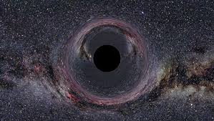
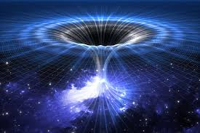
STEPHEN WILLIAM HAWKING’S THEORY ABOUT BLACKHOLE.
Stephen Hawking’s great discovery was that the mysterious regions in space we call blackholes radiate heat through quantum effects.Hawking has said that “black holesare not really black after all they glow like a hot body,and the smaller they are, the morethey glow”.Hawking’s famous theory says that the temperature of a blackhole varies inversely to its mass.

Slide 13
Thank you
for your
kind attention!

